Slide 1
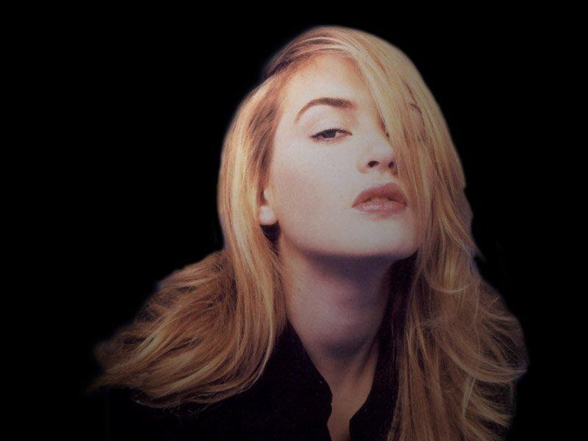
KATE WINSLET
Here is where your presentation begins

Slide 2
SELF INTRODUCTION
Name ~ Aditya Kumar
Year ~ 1st year
Dept . ~ CSE (AI & ML)
Roll No. ~ 34230821034
Subject Name ~ Language Laboratory
Subject Code ~ HMHU-291

Slide 3

INDEX
CONTENT
PAGE NO.
TILTE PAGE
SELF INTRODUCTION
INDEX PAGE
ACKNOWLEDGEMENT
INTRODUCTION OF KATE WINSLET
BIRTH
CHILDHOOD AND EARLY LIFE
PERSONAL BIOGRAPHY
OTHER VENTURES
ACTING CREDITS AND AWARDS
CURRENT WORK DETAILS
CONCLUSION
QUOTES
BIBLIOGRAPHY
THANKING SLIDE
01
02
03
04
05
06
07
08
09
10
11
12
13
14
15

Slide 4


A cknowledgement
I would like to express my special thanks of gratitude to my teacher Mr. Arnab Chakraborty, who gave me the golden opportunity to do this wonderful project of power point presentation.
Who also helped me in completing my project. I came to know about so many new things I am really thankful to them.
Secondly I would also like to thank my parents and friends who helped me a lot in finalizing this project within the limited time frame

Slide 5
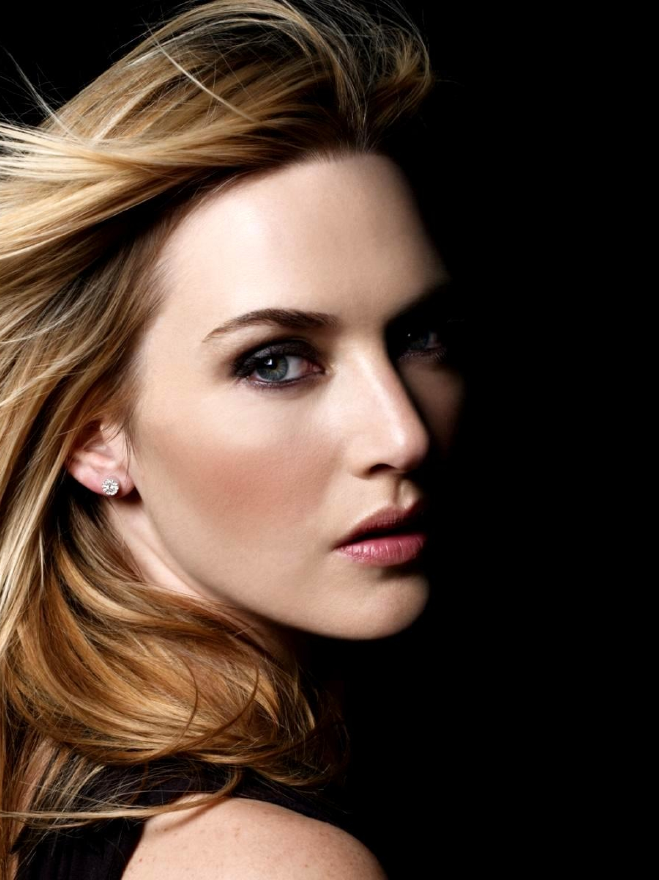
INTRODUCTION OF KATE WINSLET
Kate Winslet, in full Kate Elizabeth Winslet, English actress known for her sharply drawn portrayals of spirited and unusual women.
Best known for her portrayal of ‘Rose’ in the 1997 American epic romance and disaster film ‘Titanic’.

Slide 6
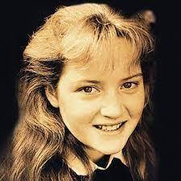
BIRTH
Kate Elizabeth Winslet was born on 5 October 1975 (age 46) Reading, Berkshire, England. Kate is of British descent, and also has Irish ancestry on her father's side and Swedish ancestry on her mother's side

Slide 7
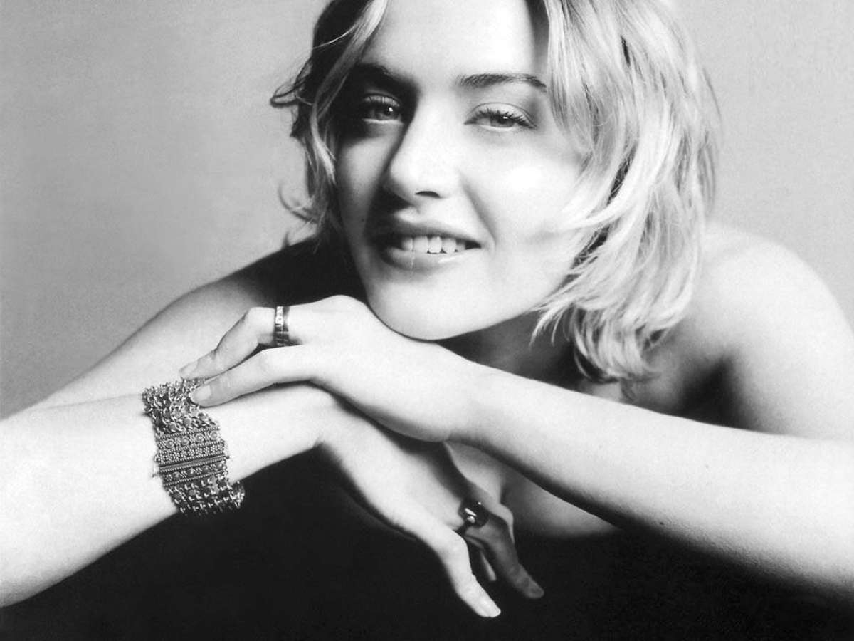
CHILDHOOD AND EARLY LIFE
She started studying drama at the age of 11 at ‘Redroofs Theatre School,’ where she was made the head girl. She appeared in her first television advertisement for ‘Sugar Puffs’ at the age of 12.
In 1988, she appeared in the TV series ‘Shrinks.’ Three years later, she dropped out of school to pursue her acting career. She soon began appearing in theater productions, such as ‘Adrian Mole,’ ‘Peter Pan,’ and the sitcom ‘Get Back.’
In 1994, she landed her debut film role in a feature film titled ‘Heavenly Creatures’ which was directed by Peter Jackson. She caught the attention of many and received praise for her acting skills when she starred in ‘Sense and Sensibility,’ which released in 1995.

Slide 8
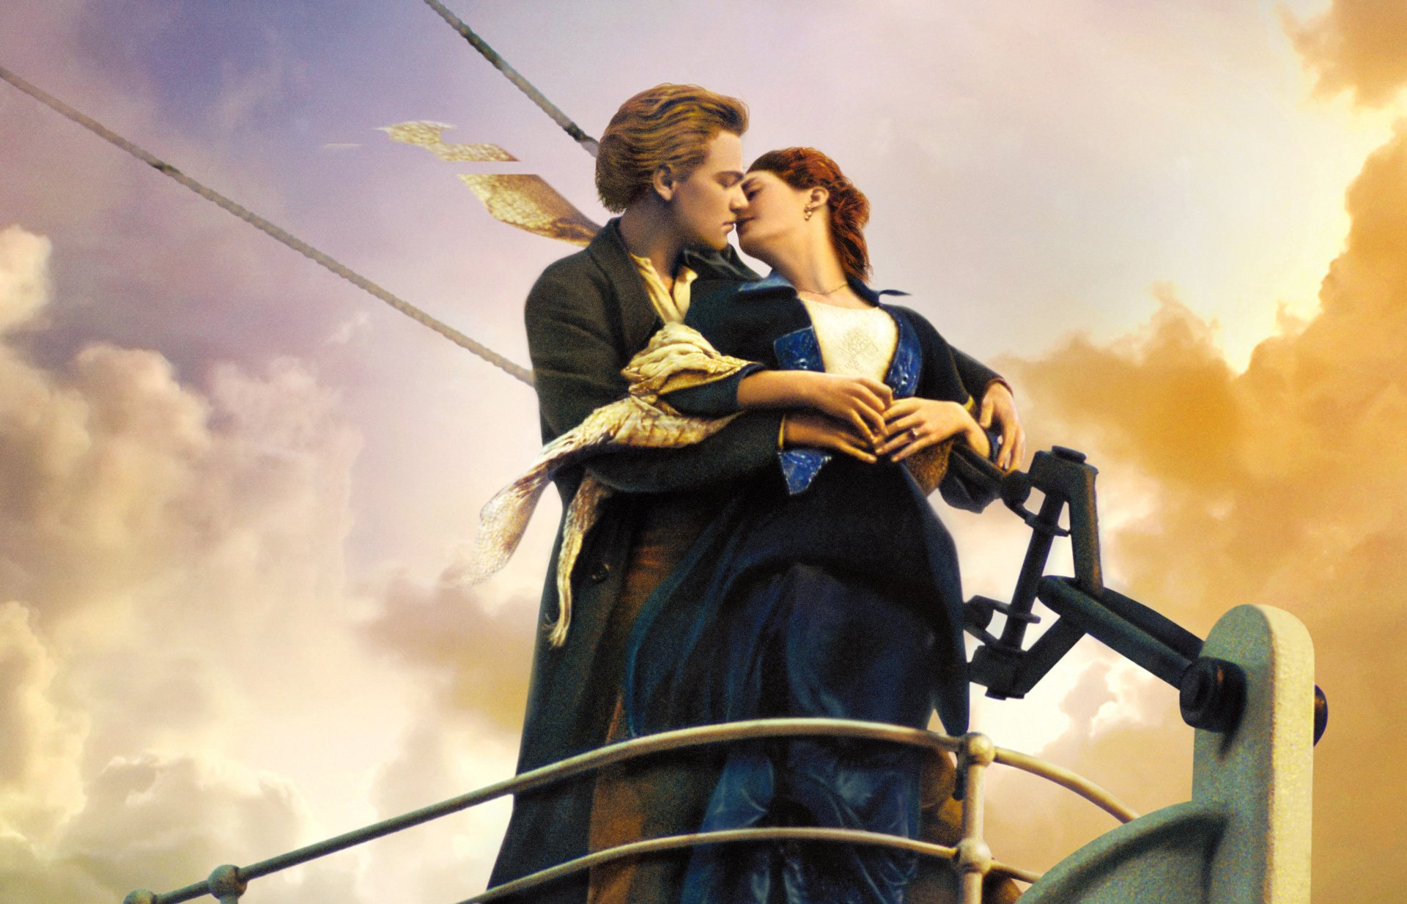
PERSONAL BIOGRAPHY
While filming Dark Season, fifteen-year-old Winslet began a romantic relationship with actor-writer Stephen Tredre, who was twelve years her senior. She considered him a major influence in her life and they lived together in London from 1991.They broke up in 1995, but remained close until Tredre died of bone cancer two years later. Winslet absented herself from the premiere of Titanic to attend his funeral. In 2008, she admitted to not overcoming his death. year after Tredre's death, Winslet met Jim Threapleton on the set of Hideous Kinky, on which he served as an assistant director. They married in November 1998 at her primary school in Reading, and their daughter, Mia, was born in 2000.

Slide 9

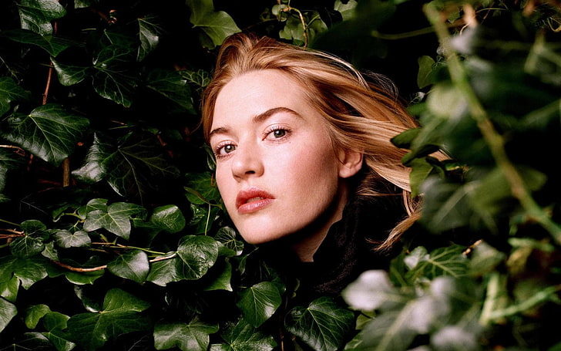

OTHER VENTuRES
Winslet has lent her support to several charities and causes , In 2006, she became a patron of a Gloucester-based charity, the Family Haven, which provides counseling services to vulnerable families. Winslet was one of the celebrities to participate in a 2007 auction to raise funds for the Afghanistan Relief Organization. In 2020, Winslet read a bedtime story as part of Save with Stories to raise funds for Save the Children's Emergency Corona virus Appeal.

Slide 10
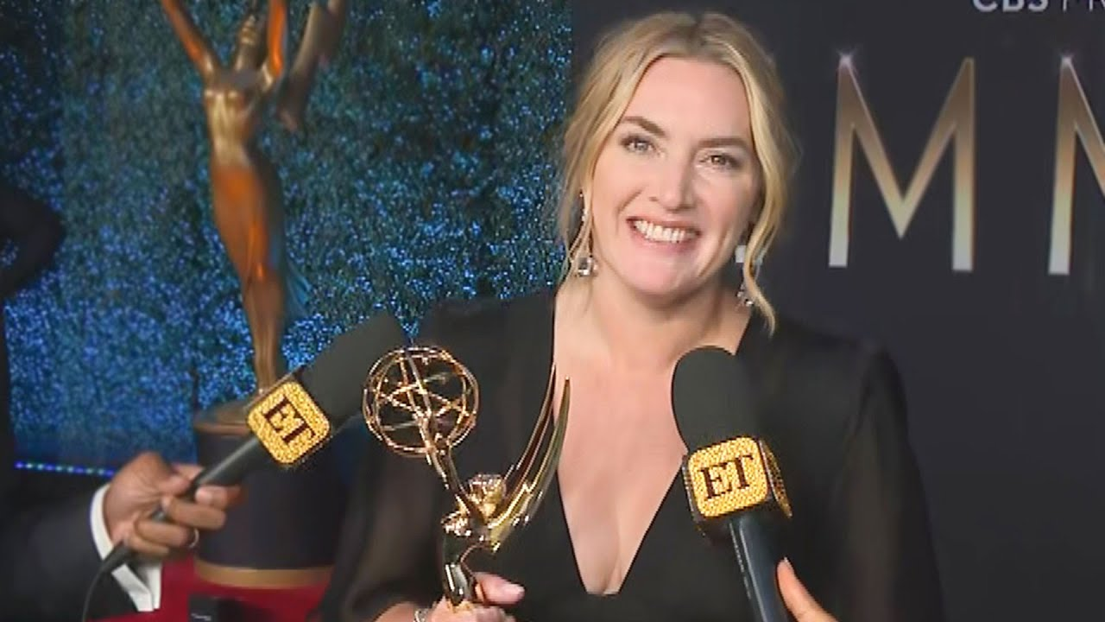
ACTING CREDITS AND AWARDS
She won a ‘Grammy Award’ for ‘Best Spoken Word Album for Children’ for ‘Listen to the Storyteller’ in 1999.
In 2001, she won the ‘Los Angeles Film Critics Association Award’ for ‘Best Supporting Actress’ for her performance in ‘Iris.’
She won an ‘Academy Award’ for ‘Best Actress’ for ‘The Reader’ in 2008.
She won two ‘Golden Globe Awards’ under the ‘Best Actress (Drama)’ and ‘Best Supporting Actress’ categories for ‘Revolutionary Road’ in 2008.
In 2011, she won a ‘Primetime Emmy Award’ for ‘Outstanding Lead Actress in a Miniseries or a Movie’ for the television show ‘Mildred Pierce.’
In 2011, she received the ‘Yo Dona Award’ for ‘Best Humanitarian Work.’
She was made a ‘Commander of the Order of the British Empire’ in 2012 for her contributions to drama.

Slide 11
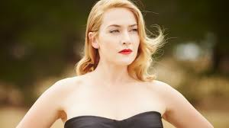
CURRENT WORK AND DETAILS
Resurgence (2020–present)Winslet portrayed paleontologist Mary Anning in Ammonite (2020), a period drama about a romance between Anning and Charlotte Murchison (played by Saoirse Ronan) set in 1840s England. And few of her next movies are Avatar - the way of water ( 2022)Avatar -the tulkun rider (2026)Avatar : 3 ( 2024)

Slide 12
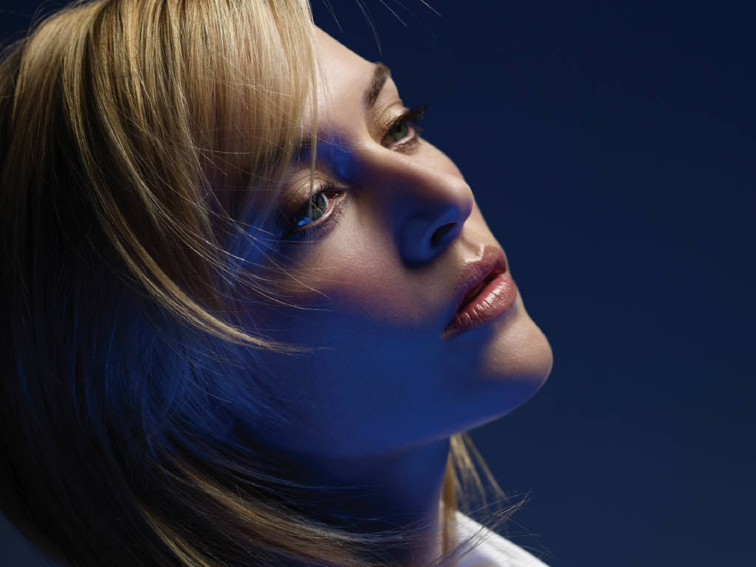
CONCLUSION
Kate Winslet is one of the most famous English actress around the globe because of her achievement and movie Titanic especially ...Time magazine named Winslet one of the 100 most influential people in the world in 2009 and 2021. She was appointed Commander of the Order of the British Empire (CBE) in 2012.

Slide 13
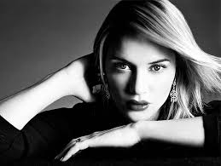

QUOTES
“I’m just a fucked up girl looking for my own piece of mind”
“Lifeis short, and it is here to be lived”.
KATE WINSLET

Slide 14
BIBLIOGRAPHY
Information :
Wikipedia , Google
Images:
99 images.com
Pinterest.com
Alamy.com
Etc.
Background
Ivy climbing plant composition with star shaped leaves rows ripe leaves
.

Slide 15


THANK YOU

